Slide 1


Notes:
Setup:
Chrome tabs: Canvas > Dashboard
Firefox tabs: Google Drive, OneDrive, 3C Media

Slide 2
Canvas 201
Advanced Canvas Tips and Tricks
Resources: bit.ly/canvas-201
Workshop #: 2018SP-6700
Presenter: Rhonda Bauerlein

Slide 3

Help!
Meet with Rhonda
bit.ly/r-meeting
24/7 Help: 1-844-592-2205

Slide 4

Dashboard
Color Overlays
Nicknames
Announcements

Slide 5
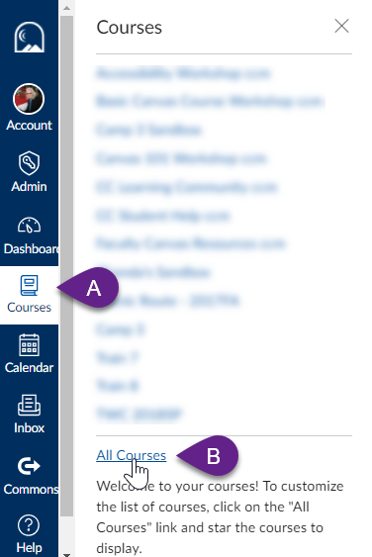

Choose Which Courses Display

Slide 6
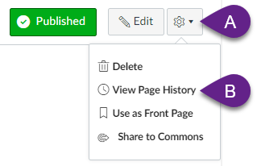
View Page History
Available on
Content Pages

Slide 7
Undelete
https://gcccd.instructure.com/courses/######/undelete
Shows most recent 25 deletions

Slide 8


Slide 9
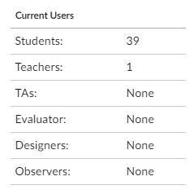
Number of Students in Course
Settings > Sidebar

Slide 10
Rich Content Editor (RCE)

Slide 11
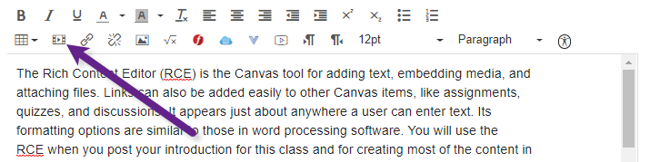
RCE: Embed Tool
Notes:
Help > search for overview > select videos > get embed code

Slide 12
YouTube
Link
Embed code
LTI
https://youtu.be/psGDf2VrvK8

Slide 13


Slide 14
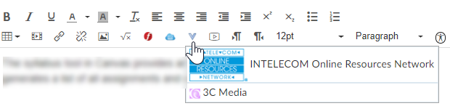
Captioned Videos

Slide 15
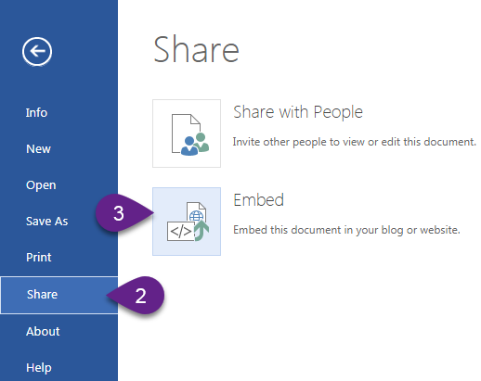
MS OneDrive
File
Share
Embed

Slide 16
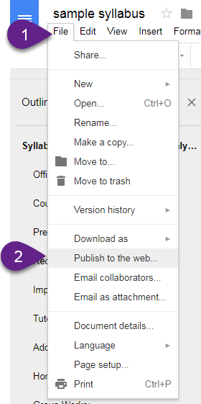
Google Docs
File > Publish to the web…> Embed> Publish

Slide 17
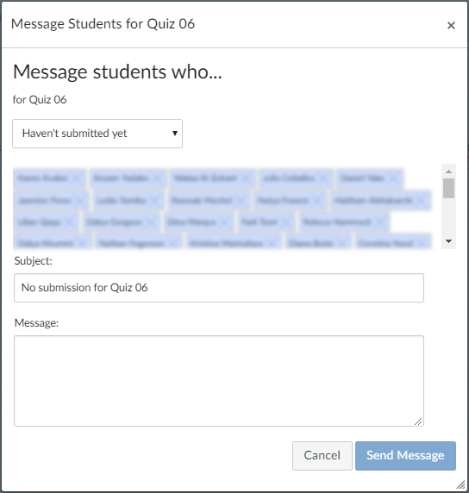
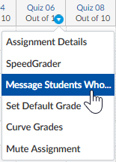
Gradebook - Message students who…

Slide 18
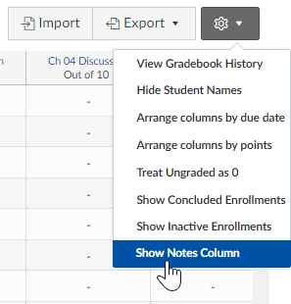
Gradebook Notes Column

Slide 19
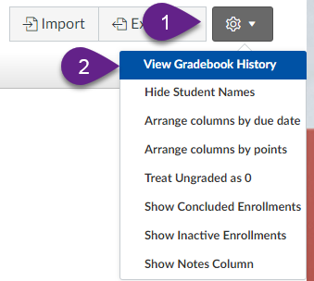
View Gradebook History
Options icon
View Gradebook History

Slide 20
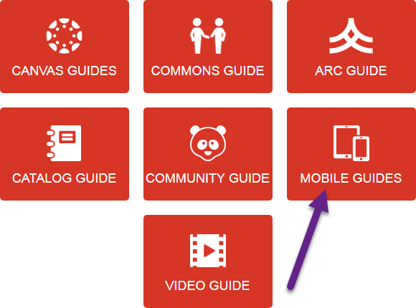
Apps
Help > Search the Canvas Guides > Mobile Guides

Slide 21
Redirect LTI
Settings > Apps tab at the top
Search for redirect
Click the icon
+ Add App
Type text for link in Name field
Copy/paste the URL of the website you want to go to into the URL Redirect field
Check Show in Course Navigation

Slide 22
Keyboard Shortcuts

Slide 23
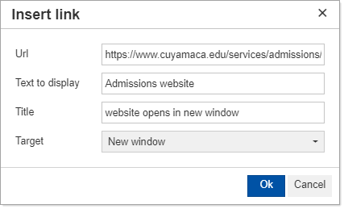

Hyperlink

Slide 24

Find

Slide 25
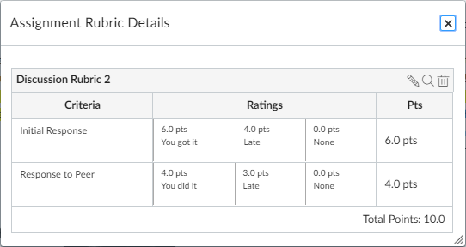
Rubrics

Slide 26
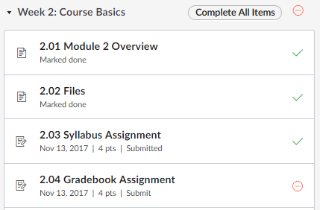
Requirements

Slide 27

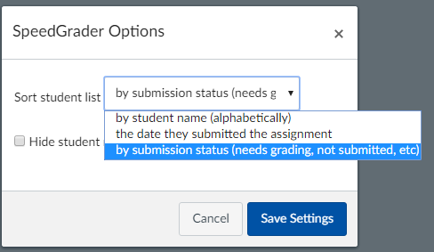
Speedgrader Settings

Slide 28
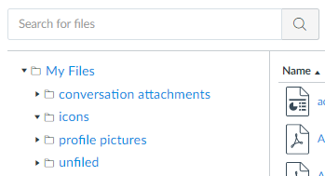
Copy Files From Another Course
Account > Files

